Slide 1
Split Plot Design
March/6/2018

Slide 2
Definition
Split plot design involves a specialized randomization scheme for a factorial experiment in 2 stages:
First, level of factor A are randomized over the main plot
Then level of factor B are randomized over the subplot within each main plot
Such randomization restriction results in the presence of two distinct experimental units and two distinct error terms
Treatments applied to main plot are subject to larger experimental errors than those applied to subplots
Higher precision in estimating the mean of treatments assigned to subplots

Slide 3
Split Plot Design Concepts
Levels of the Experiment Units
Main Plot
Sub Plot
Treatment Arrangement
Crossed (unlike Hierarchical model, the treatment arrangement is nested)
2-way treatments – Split plot
3-way treatments –split split-plot
Error Structure
Main Plot Error
Sub Plot Error

Slide 4
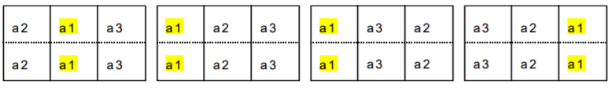
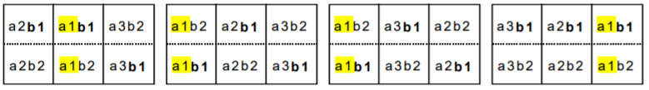
Split plot RBD Randomization
Stage 1: Randomize the levels of factor A over the main blocks
Stage 2: Randomize the levels of B over the subplots, 2 per subplot

Slide 5
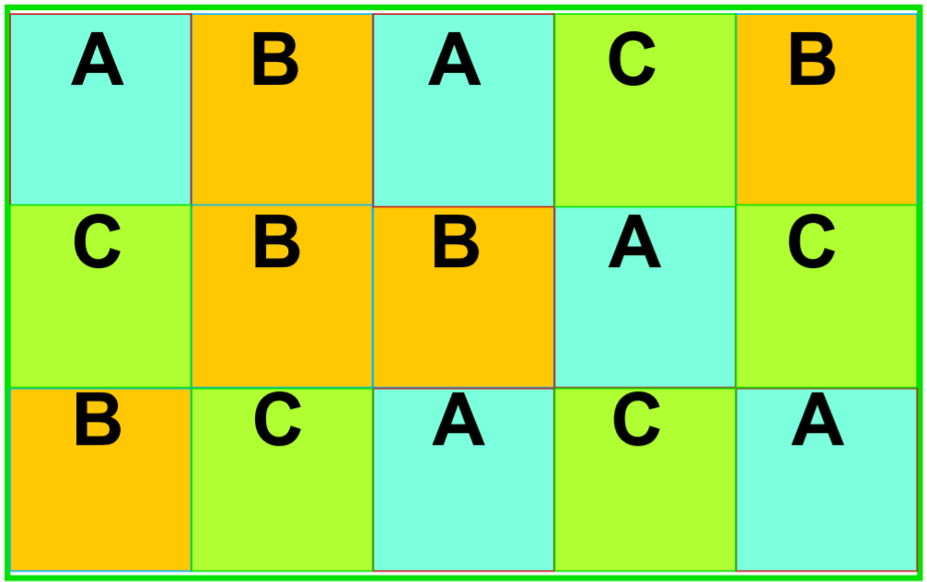
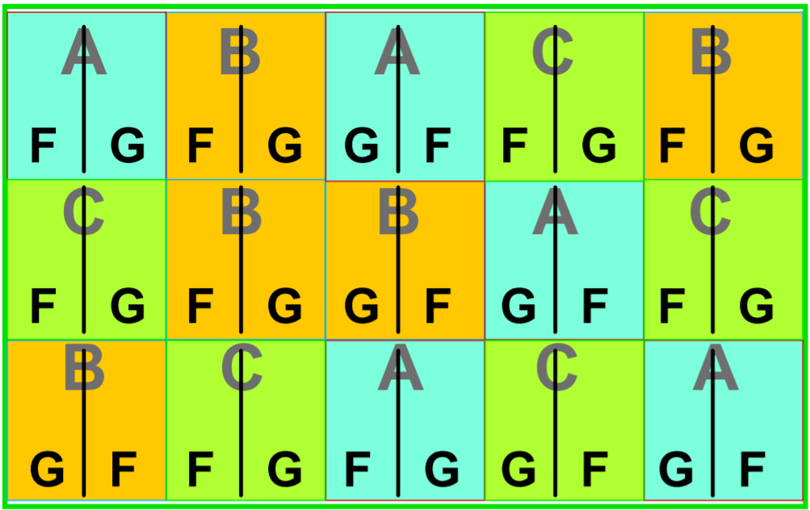
Treatment Arrangement – CRD for Mainplot
Main Plot – 3 Levels, Replicated 5 times
Sub Plot (2 levels)

Slide 6
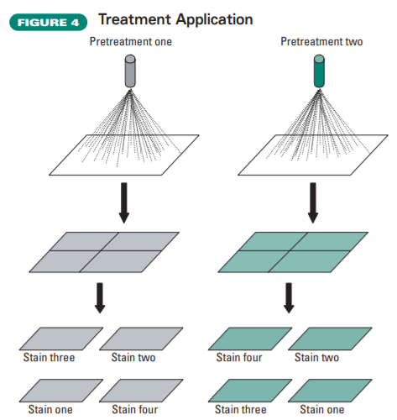
Source Table for the ANOVA
Example in Product Engineering:
Water resistance property of treated wood
Main treatment: Pretreatment Solutions
Sub plot: four types of stain
Source | DF
Main Treatment | t1-1=2
Error(a) | t1(n-1)=3(5-1)=12
Subplot Treatment | t2-1=1
Main x Subplot | (t1-1)(t2-1)=2
Error (b) | t1(t2-1)(n-1)=3*1*4=12
Total | 3*5*2-1=29
Example in Agriculture:
We may have main treatment of Fertilizer and then the herbicide treatment 1 applied to half of the main plot, and herbicide treatment 2 applied to another half of the field

Slide 7
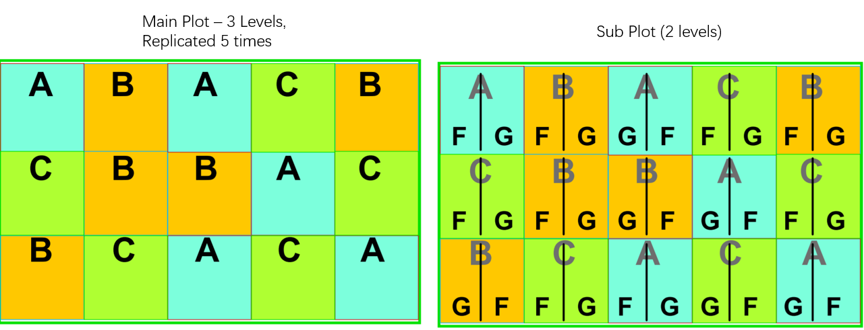
How to Recognize a Split Plot
Anytime when you see a treatment levels occurs within an Experimental Unit

Slide 8
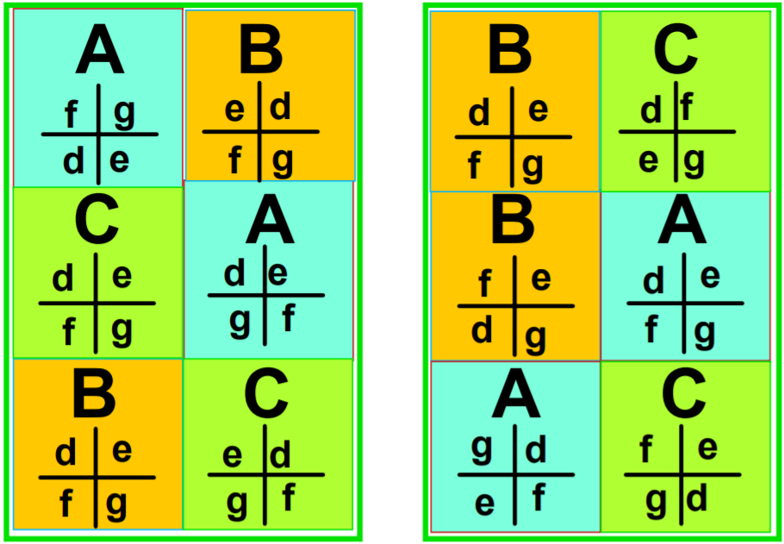
Treatment Arrangement –RBD for Mainplot
Main Treatment t1=3
Block b=2
Splitplot Treatment t2=4
For the main plot treatment, the analysis is the same as RBD

Slide 9
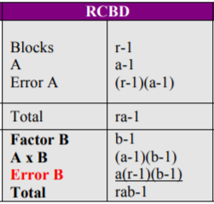
Source Table for the ANOVA
Source | DF
Main Treatment 1 (T1) | t1-1=2
Block | b-1=1
B x T1 (Error a) | (t1-1)(b-1)=2
Subplot Treatment 2 | t2-1=3
Main T1 x Subplot T2 | (t1-1)(t2-1)=6
Residual (Error b) | t1*(b-1)(t2-1)=3*1*3=9
Total | B*t1*t2-1=2*4*3-1=23

Slide 10
Model Statement
Proc GLM;
Class Block A B;
Model Y = Block A Block*A B A*B;
Random Block Block*A;
Test h = A e = Block*A;
Run;
Proc MIXED covtest;
Class Block A B;
Model Y = A B A*B;
Random Block Block*A;
Run;

Slide 11
Experiment Example (RBD)
To determine the effect of bacteria on the root yield of sugarbeets planted at different in-row spacings
Main factor: Inoculation
Subplot factor: spacing levels within the main plot
A total of 6 blocks
Reasoning of the design (why not CRD in the main plot)
To confine the inoculum as much as possible to its assigned plots
To allocate precision in the experiment to where it is needed most
Larger differences between healthy and diseased plants as you would expect
Relatively smaller differences in yield due to in-row spacing effects

Slide 12
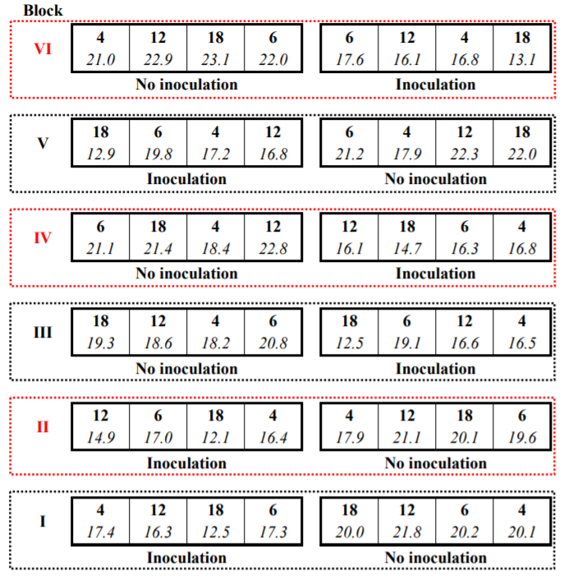
Split-plot field layout of the sugar beet root rot study. Each block contains 2 main plots, to which the inoculation treatment levels were assigned (Inoculation, No Inoculation). Each main plot is split into 4 subplots, to which the in-row spacing levels were assigned (4, 6, 12, and 18 inches). The yields of the subplots are shown in italics.

Slide 13
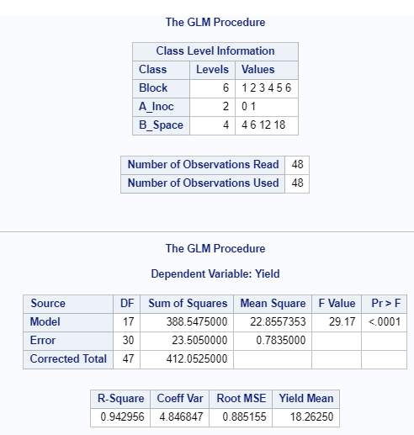
SAS Code
filename input '/folders/myshortcuts/Math318/my_download/SPLITBEETS.txt'; data splitbeets; infile input missover firstobs=2 dlm='09'x; input A_Inoc Block B_Space Yield; cards; proc sort; by A_Inoc; run;
Proc GLM; Class Block A_Inoc B_Space; Model Yield = Block A_Inoc Block*A_Inoc B_Space A_Inoc*B_Space; random Block Block*A_Inoc; Test h = A_Inoc e = Block*A_Inoc; Test h = Block e = Block*A_Inoc; Means A_Inoc /lsd; Means B_Space /lsd; Means A_Inoc*B_Space lsd; Run;

Slide 14
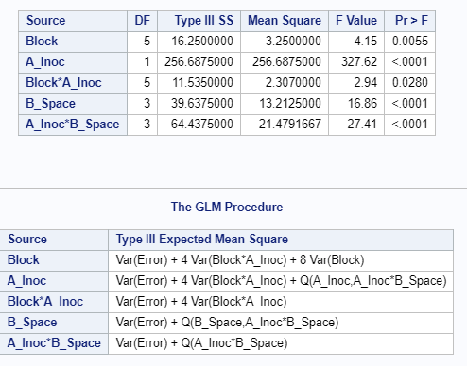
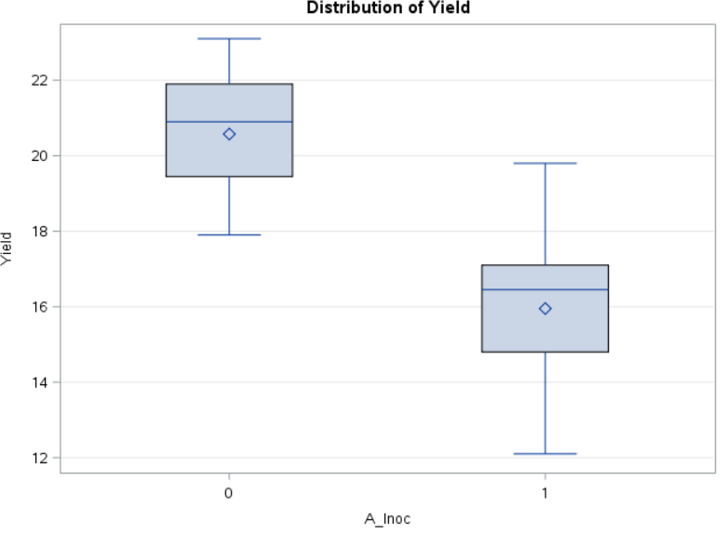
How to Estimate Var(Block)
Please calculate

Slide 15
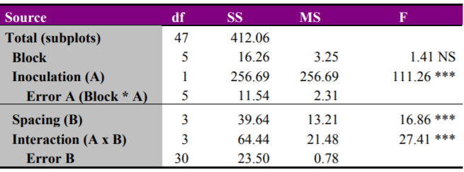
Error for whole plot and Error for split plot
The mean of yield is 18.26
The CV for wholeplot is Squareroot(2.31)/18.26*100%=8.3%
The CV for split plot is squareroot(0.78)/18.26*100%=4.8%
Interpretation of the ANOVA:
The MS Error for whole plot is 2.31; the MS error for the split plot is 0.78; confirmed the theoretical expectation of the difference (bigger for wholeplot error)
There is a significant interaction between AXB; indicates that the magnitude of the difference between inoculation treatments depends on in-row spacing, and vice-versa

Slide 16
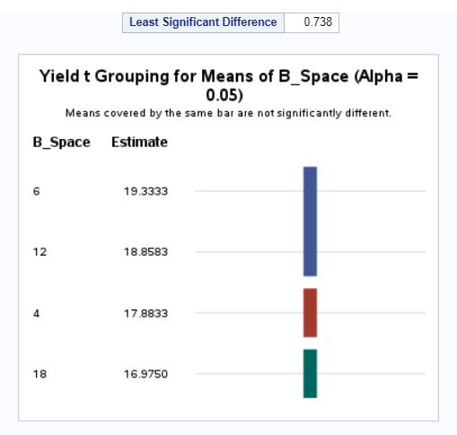
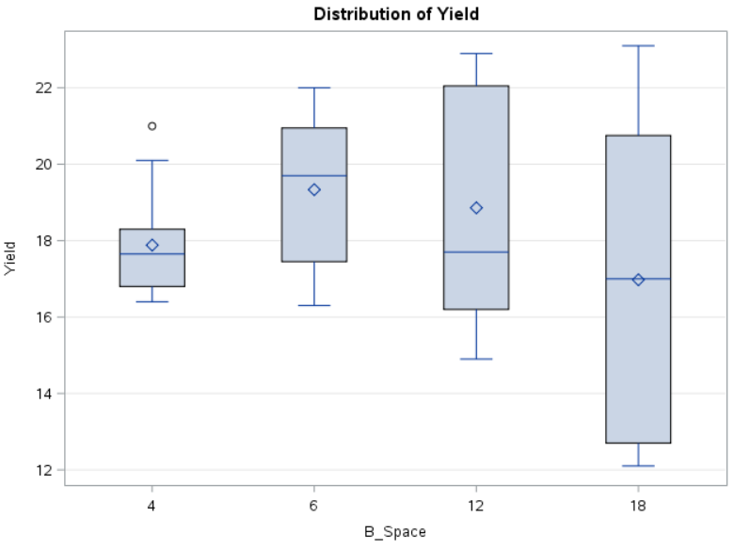
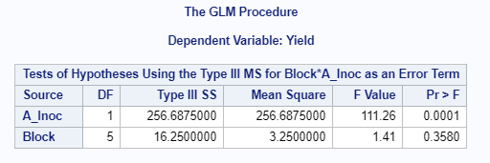

Slide 17
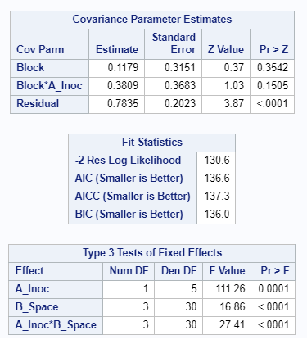
Model using Proc Mixed
Proc mixed covtest; Class Block A_Inoc B_Space; Model Yield = A_Inoc B_Space A_Inoc*B_Space; random Block Block*A_Inoc; lsmeans A_Inoc /adjust=bon; lsmeans B_Space /adjust=bon; lsmeans A_Inoc*B_Space /adjust=bon; Run;
Test is correct; no need to specify in model statement
When the interaction between treatments is significant, There is a problem here; you can not make General comparisons between levels of B_Space; now you can condition on the level of A_Inoc

Slide 18
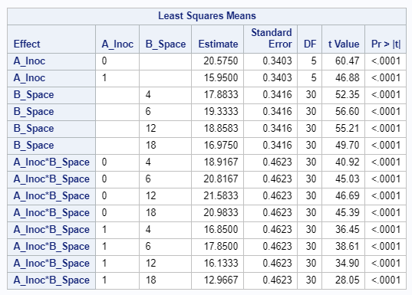

Slide 19
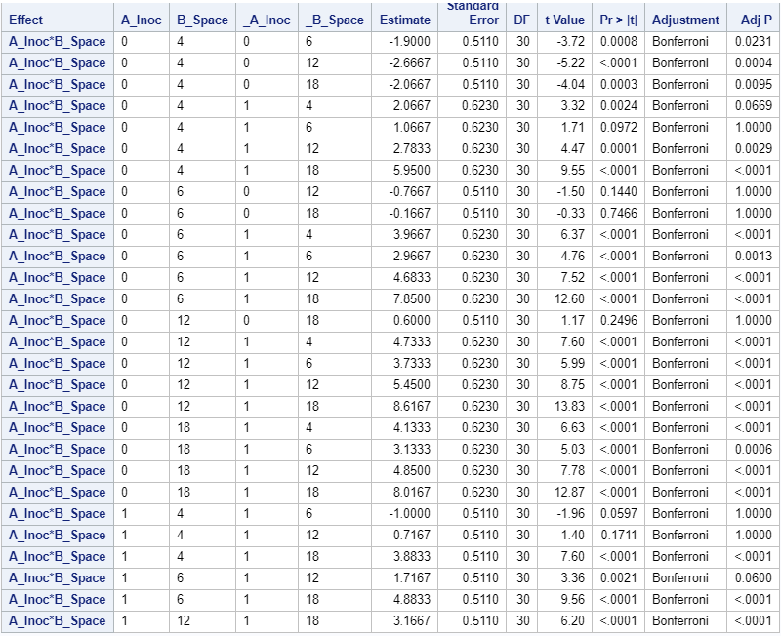
Conditional on A_Inoc level 0 or Level 1, ……

Slide 20
Output lsmeans
ods output lsmeans=lsm diff=lsdiff estimates=estdiffs; Proc mixed covtest; Class Block A_Inoc B_Space; Model Yield = A_Inoc B_Space A_Inoc*B_Space; random Block Block*A_Inoc; *lsmeans A_Inoc /adjust=bon; *lsmeans B_Space /adjust=bon; lsmeans A_Inoc*B_Space /adjust=bon; Run; proc plot data=lsm; plot Estimate*B_Space=A_Inoc; run;
This maybe useful for the Quiz

Slide 21
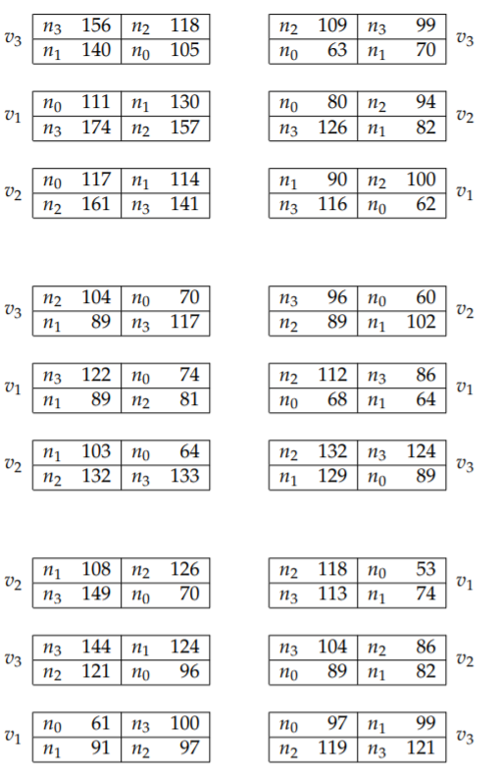
Quiz
In a field experiment with three oats varieties v1, v2, and v3, and four equidistant levels of nitrogen n0, n1, n2, and n3, the yield of oats in quarter pounds was observed. The varieties were sown in 6 randomized blocks with three plots in each block, and with each plot divided into four subplots. The data and design, from Yates (1935), are reproduced in the following table: (data set is oats.txt)

Slide 22
Quiz Questions
Write Down the Correct ANOVA Table from Proc GLM (3 points)
Is there a significant interaction between 2 treatments? (2 points)
Calculate VAR(Block) and show the steps (2 points)
Plot the interaction plot of the mean yield of variety and nitrogen (3 points)

Slide 23
Recommended Reading for Data Science Major
http://courses.csail.mit.edu/18.337/2015/docs/50YearsDataScience.pdf

